Slide 1


Tableau Dashboard
KPMG Data Analytics Task 3:
Data Insights and Visualization Using Tableau Software
SHUBHA HEGDE

Slide 2
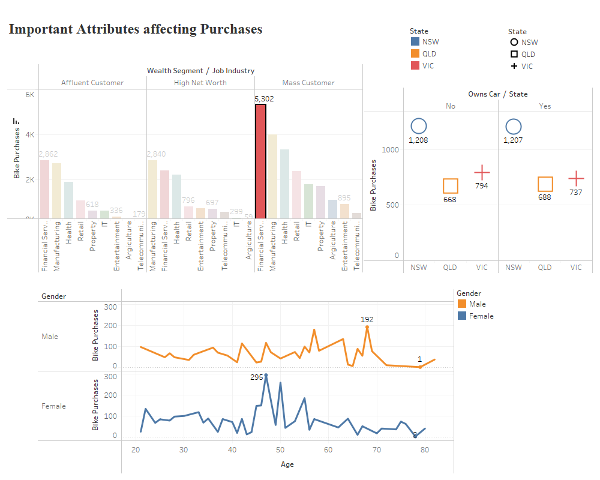

Slide 3
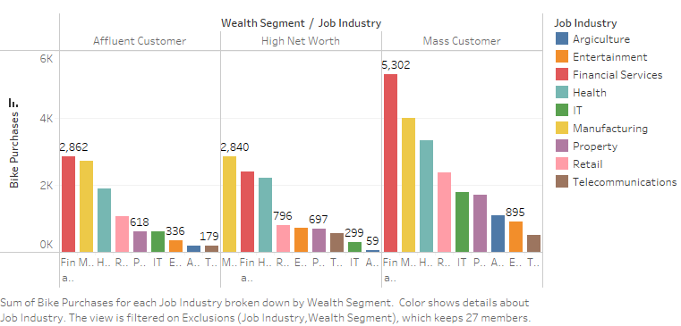

Slide 4
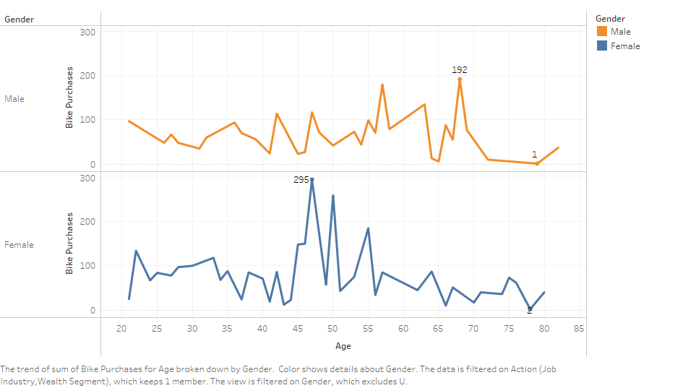

Slide 5
